Slide 1
HR ANALYTICS DASHBOARD

Slide 2
INDEX
Introduction
Employee Workforce Metrics
Gender Distribution
Attrition Rate v/s Monthly Income Status
Job Role v/s Work Life Balance
Average Attrition Rate for each Department
Attrition Rate vs Year since Last Promotion
Average Working Years for each Department
Suggestions & Areas to Improve
Conclusion

Slide 3
INTRODUCTION
What is Employee Retention?
Employee attrition rate?
What influence an individual's decision to continue or quit?
How to improve retention?

Slide 4
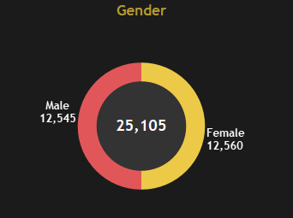
GENDER DISTRIBUTION
Observations
Employee diversity
Gender equality
Attrition rate not depending on gender
Equal head count for both male and female
Equal attrition count for male and female

Slide 5
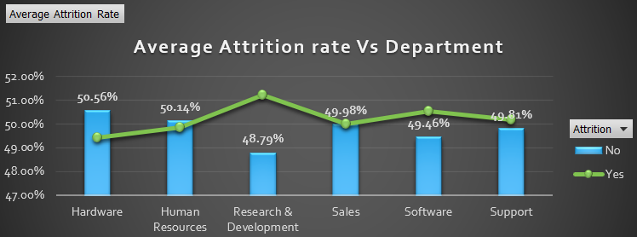
AVERAGE ATTRITION RATE FOR EACH DEPARTMENT
R& D - Highest attrition rate
01
Software – High attrition rate
02
Support & Sales also high
03
Hardware – Less attrition rate
04

Slide 6
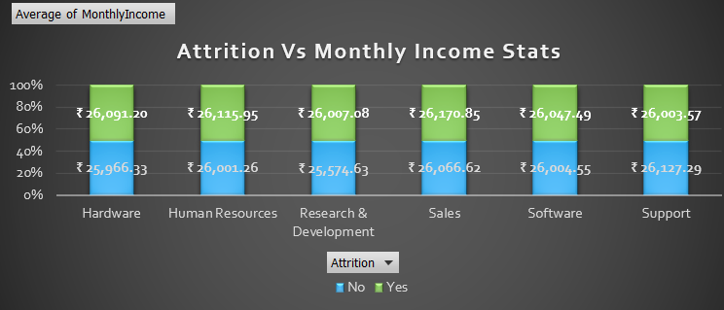
AVERAGE ATTRITION RATE v/s MONTHLY INCOME STATUS
R&D – Highest attrition rate and lowest income
Software – More the attrition rate lesser the income
Sales – More income still attrition rate high
HR & Support – More income, but attrition high
Hardware – Attrition rate is low
Observations
1. There is a tendency for higher average monthly income to correlate with lower attrition rate.

Slide 7
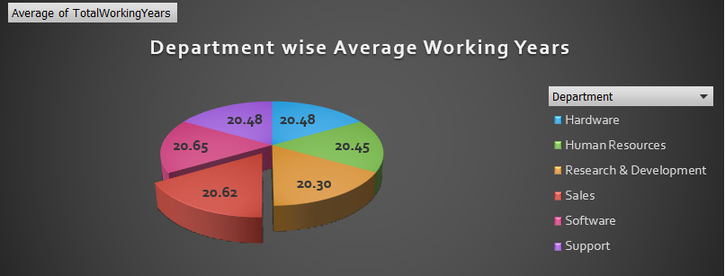
AVERAGE WORKING YEARS FOR EACH DEPARTMENT
Software and sales have highest average working years
R & D have low value for Average working year.
Observations
Company Culture
Workplace Flexibility
Job Autonomy
Work Life Balance
Career growth
Monthly income

Slide 8
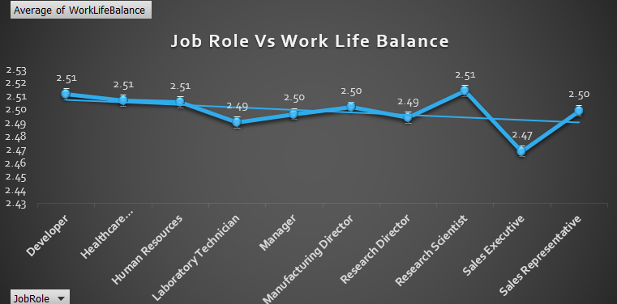
JOB ROLE v/s WORK LIFE BALANCE
Developer, R&S - Highest work life balance
HC Rep , HR – High work life balance
Sales Ex – Lowest work life balance
LAB Tech, R&D – Low work life balance
Observations
Work life balance is also a reason for attrition.
High-pressure jobs with poor work- life balance
Roles with High Autonomy and Good work life balance

Slide 9
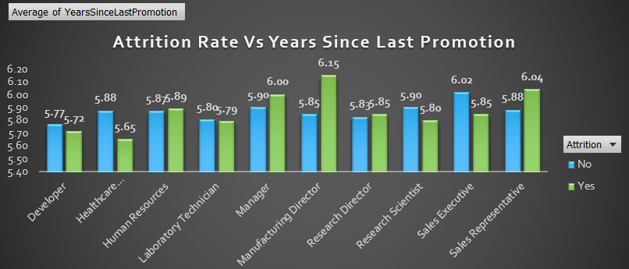
ATTRITION RATE v/s YEAR SINCE LAST PROMOTION
For most of job role a longer time since last promotion also have a higher attrition rate.
Observations
Employees who haven't been promoted in a while are more likely to leave an organization , leading to higher attrition rates.

Slide 10
SIGNIFICANCE & AREA TO IMPROVE
Compensation and Benefits
Salary & Wages, Bonus, Health Insurance , After retirement benefits , Promotions etc.
Work Life Balance
Flexible work environment , Flexible work timings, wellness programs l like gym, Supportive work culture, collaboration and teamwork , open communication within the team, fun activities in the floor in a monthly or twice in a week manner, stress from workload, support in tough times and in personal crisis.
Career Growth
Feedback on the performance , recognize and appreciate the achievements , provide training and development etc.

Slide 11
CONCLUSION
Employee retention is crucial for the long term health and success of the business. Retaining best employees ensures customer satisfaction, product sales, satisfied co-workers, and goodwill of the organization.
In a nutshell, "If you truly respect, appreciate and treat your employees wonderfully, you will never lose them"!!!!!

Slide 12
THANKYOU

